Slide 1
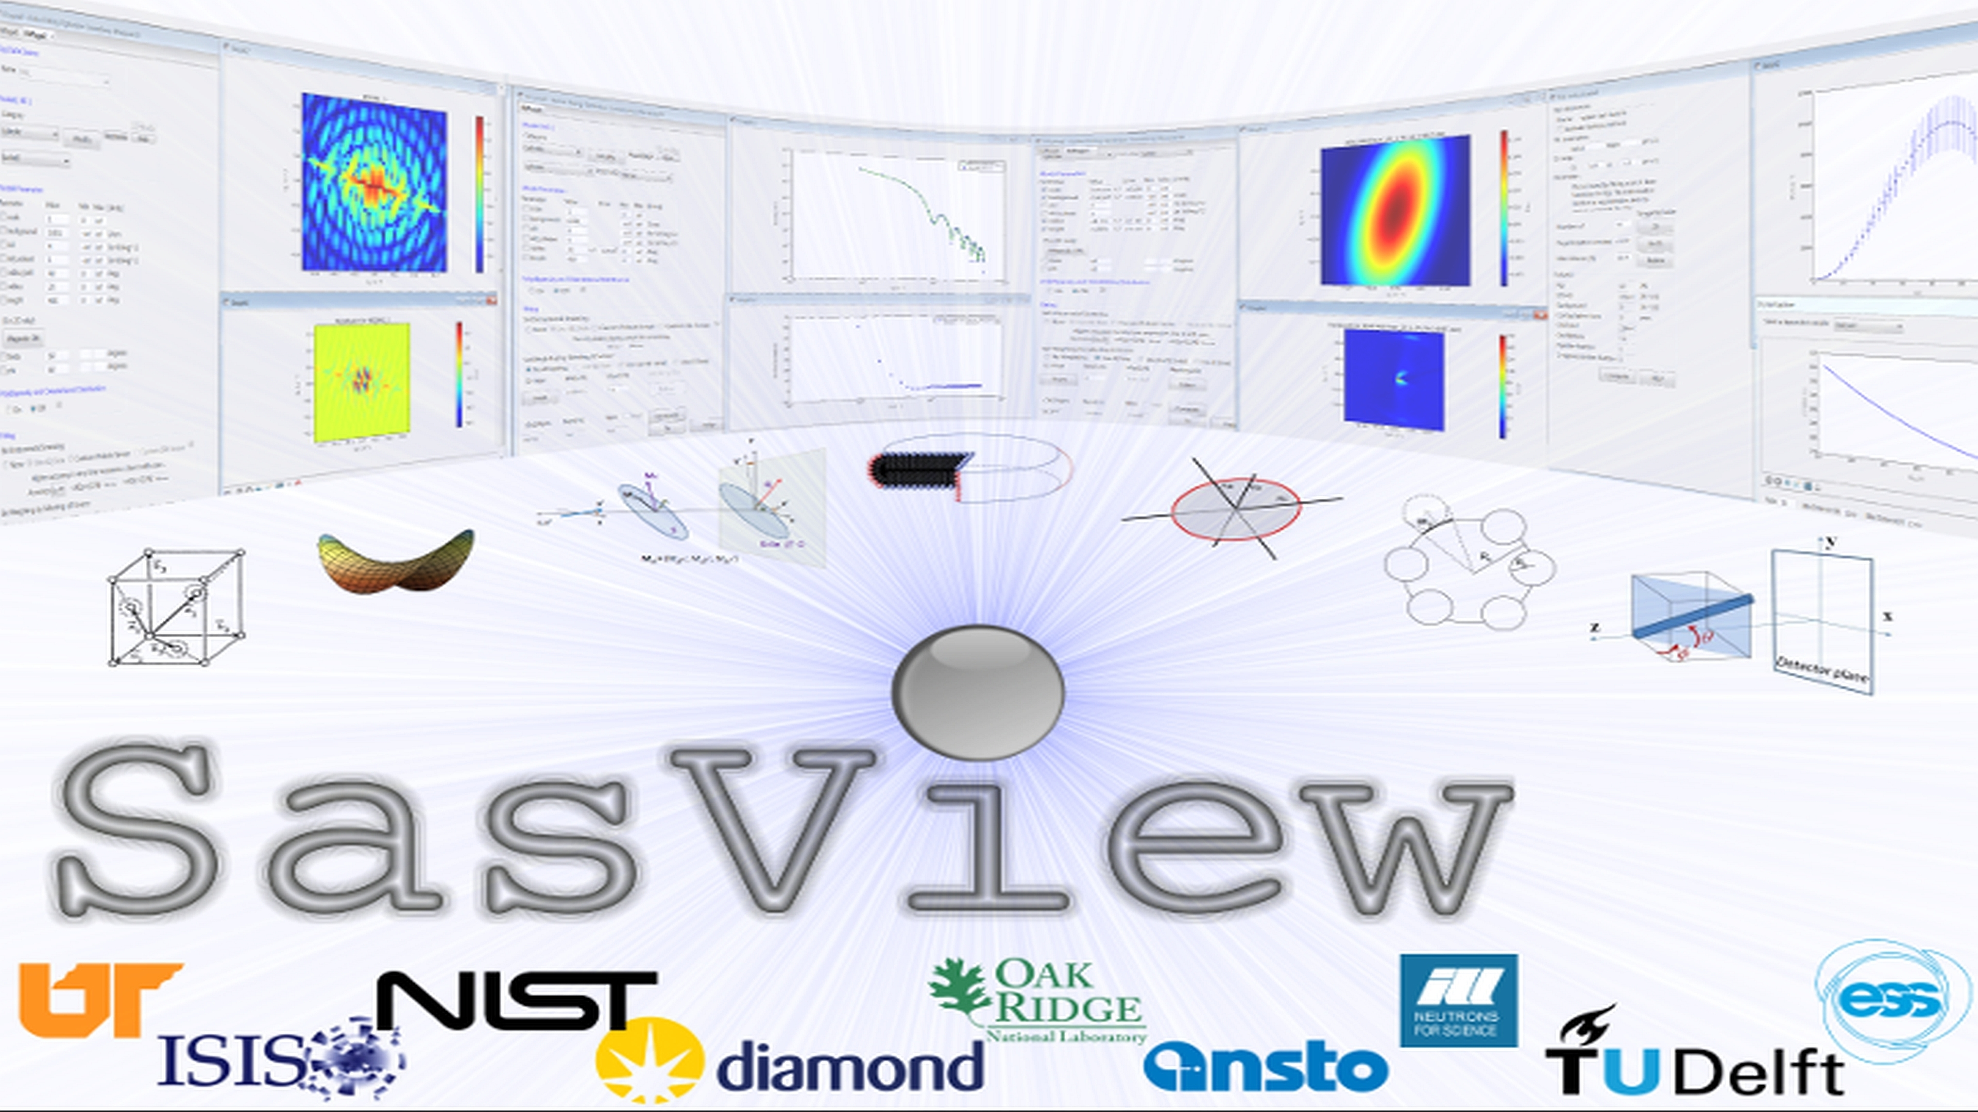
Addressing the Resource Problem Through Community

Slide 2
The resource Problem Part I
Analysis? Let's define that
"Works on data from which all instrumental artifacts have been removed"
…. sortof
Instrument Independent Data
$$MONEY$$
Source Construction
Reduction Sofware
Civil Construction
Data Hardware
Analysis
Software??
Instruments
Time

Slide 3
The resource Problem Part I
Analysis Software - Who’s Job is it Anyway?
Scattering is an analysis tool and part of providing the tool should be the necessary software
→ the FACILITY’S JOB
$$MONEY$$
Analysis is where the science is
→ the USER’S JOB
Source Construction
Reduction Sofware
Civil Construction
Data Hardware
Analysis
Software??
Instruments
Or maybe …..
→ The Domain Science funding agencies?
Time

Slide 4
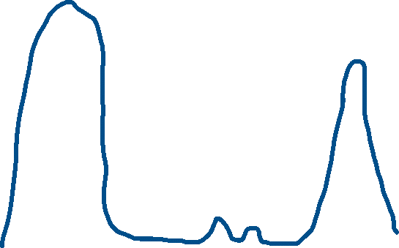
The resource Problem Part II
The feast and famine roller coaster
The Valley(s) of death
Analysis Software - Who’s Job is it Anyway?
- The domain science funding agencies
Facility directors discretion, NIH, NSF, DOE, etc.
Special funding (grants) do no fund long term maintenance and ongoing development. They fund “big new (transformative) ideas”
$$MONEY$$
Time

Slide 5
The resource Problem Part III
The unbounded problem
Fundamentally all these elements are relatively well defined problems…
EXCEPT ...
Analysis Software is really unbounded. The needs are nearly infinite and constantly evolving.
$$MONEY$$
Source Construction
Reduction Sofware
Civil Construction
HOWEVER --- Analysis as defined here is also uniquely universal and ripe for collaborative pooling of finite resources
…. But beware the monoculture?
Data Hardware
Analysis
Software??
Instruments
Time

Slide 6
The Problem Statement
A way to focus limited resources on top priorities (most useful to the science being done) in a world of infinite possibilities
A way to harness funding for bold new ideas without losing the investment in the valleys of death
A way to provide sustained maintenance and development in an uncertain funding environment (thriving through the famines)
FACTS OF LIFE:
Resources are finite
Needs are infinite

Slide 7
So, How Can we Solve the Problem?
Step One: Collaboration.
Let's all work together for the common good
The Reality: Collaboration is REALLY HARD!!
Lesson 1: Work with me NOT for me

Slide 8




Serendipity: Some history
SansView was DANSE project output
~ 8.5% of funds were for SANS
+ BUMPS … see later
2006
2011
2012
NIST Supported initial transition from NSF funding
2013
Transition to Community project.
1st Code Camp at NIST April 2013
2014
2nd Code Camp at ISIS April 2014
Move to GitHub
v3.0 released
3rd Code Camp at ESS Feb 2015
2015
Rename to SasView
v3.1 released
2016
4th Code Camp at TU Delft March 2016
v4.0 released
5th Code Camp at ORNL Oct 2016
v4.1 released
6th Code Camp at ILL/ESRF April 2017
2017
7th Code Camp at DMSC October 2017
8th Code Camp at ESS Sept 2018
2018
v5.0b1 released
v4.2 released
1st SasView User Meeting at SAS2018
v4.2.1 released
2019
v5.0b2 released
9th Code Camp at ILL/ESRF March 2019

Slide 9
Some More Lessons Learned
Nobody owns fewer egos
No proprietary platform (open source python – eventually some C)
Must align with the needs and the priorities of each person/facility
Community building is integral/essential to the effort
"Small" money can be blessing
More freedom for experimentation
Provides better motivation for collaboration
Getting to collaboration was a huge amount of work but …. there was also a LOT of luck

Slide 10










The SasView Aproach
An
“open, collaborative, community development”
platform for
Small Angle Scattering Data Analysis

Slide 11
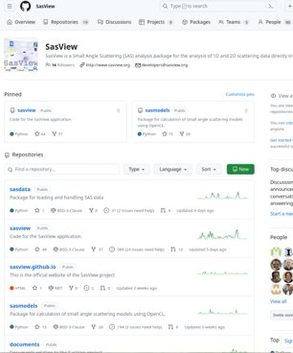
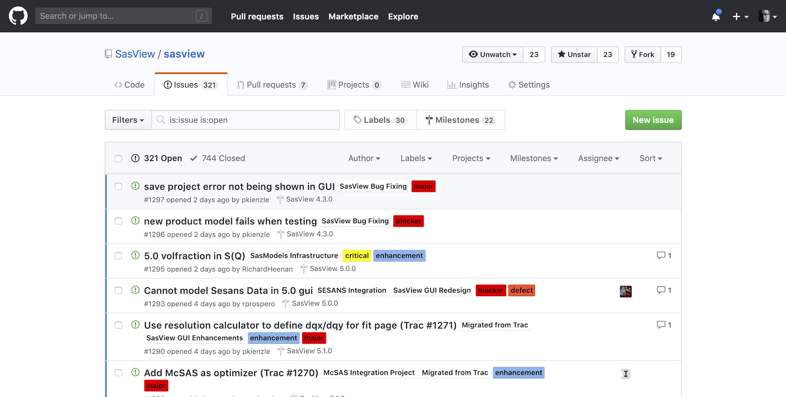



Open, Collaborative, Community Development
Code is open source and publicly hosted at Github
Released under BSD 3-clause license
Code Hosting, Issue Tracking, Developer Wiki & CI on Public Github repos
(Zenodo) DOI for each release
Rolling 5 Year Roadmap
https://www.sasview.org
https://github.com/SasView

Slide 12
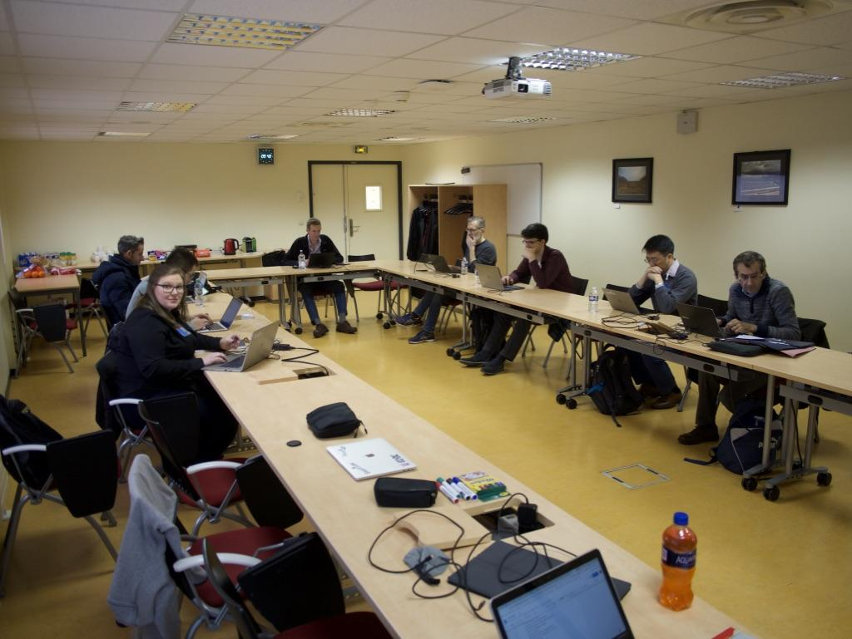
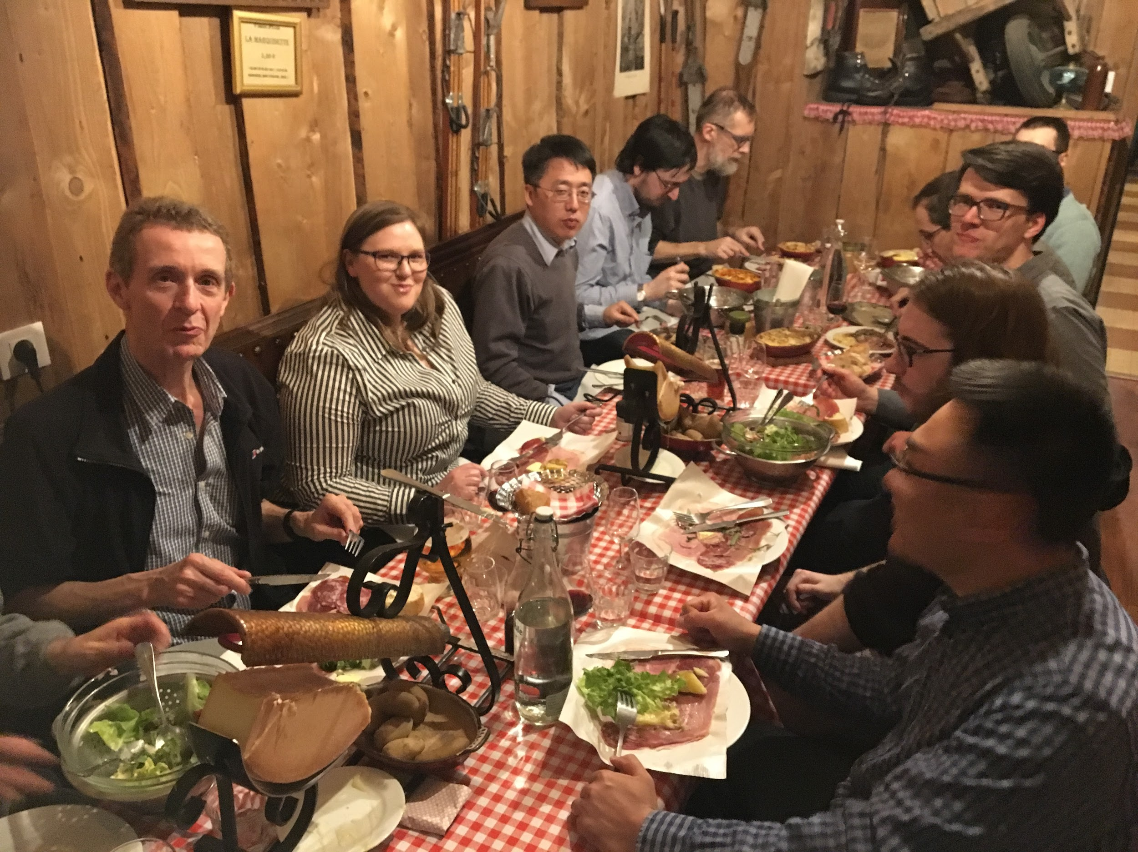
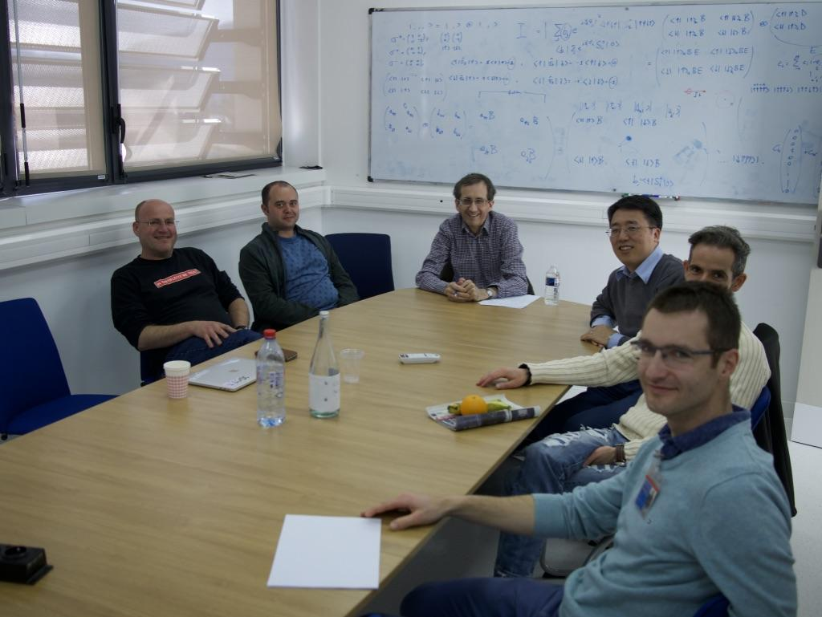
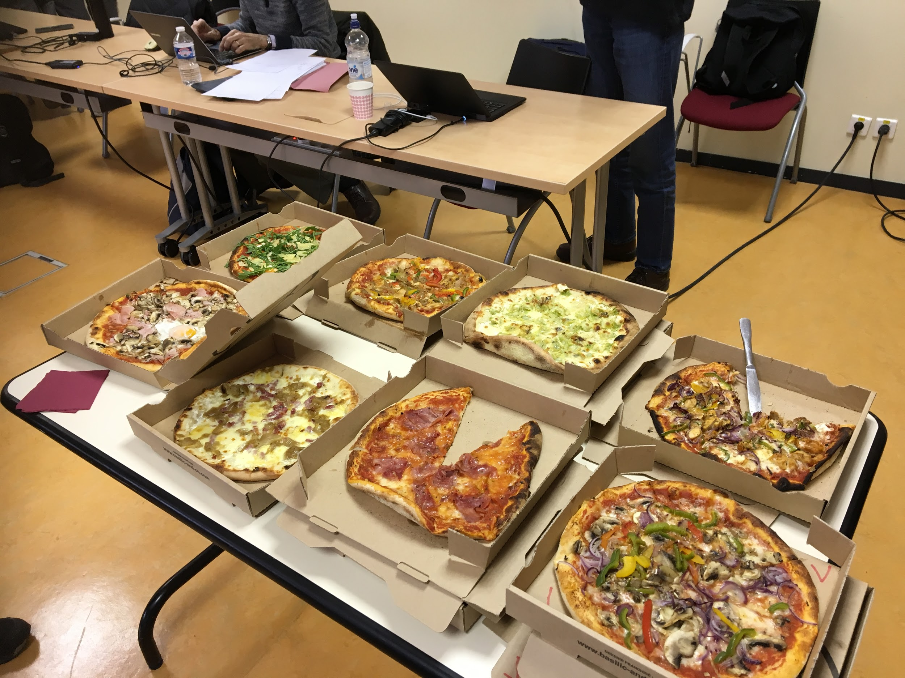
Open, Collaborative, Community Development
Twice monthly zoom calls
Regular ‘camps’ & ‘hackathons’
Developer's mailing list
SasView slack
Expertise sharing and helping
Small leadership team to facilitate
Collaboration also builds
Community
http://www.sasview.org
http://github.com/SasView

Slide 13
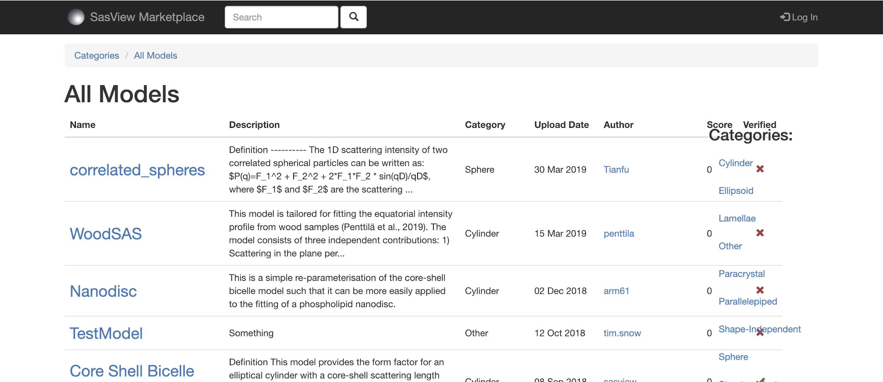
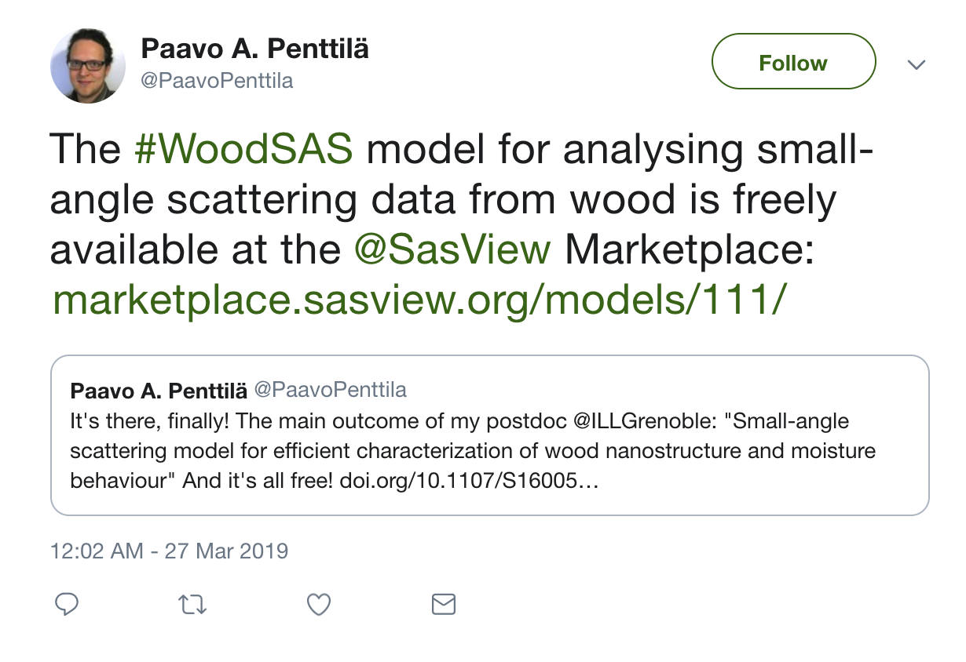
Open, Collaborative, Community Development
Ask not what the community is going to do for you,
ask what you can do for the community
P. Butler, March 2019
No MOU ... all are invited and welcome
Two Basic "Rules"
He who pays the piper gets to choose the tune…
Those who bring the resources (time and effort, or funds to buy time and effort) choose what to work on.
And ...
You cannot break existing experiences ...
New dependencies vs long term maintenance (sustainability)
Code quality vs long term sustainability
Changing/degrading the current user experience for the existing user base
http://marketplace.sasview.org
Model Marketplace for Users to share their models
http://www.sasview.org

Slide 14
SasView Today

Slide 15
Basic Structure of code base
sasview
sasdata
sasmodels
bumps
GUI (QtGui)
sascalc
Pip install sasmodels sasdata
Need to finish separating GUI from sascalc … discussion on how
Documenting entry points to GUI functionalities

Slide 16
DATA MANAGEMENT
Recently moved to sasdata
Most all 1D data types supported on input
Standard data supported (cansas1D and NXcanSAS)
Some image and odd data supported through converters
All data output in NXcanSAS format
Calculated curves associated with data (PQ, SQ, desmeared model, etc)
Project saving capabilities (currently a bit fragile)

Slide 17
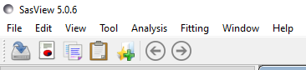

SasView Toolkit for SAS data Analysis
Perspectives on the data
Tools
Data Operation
SLD calculator
Density/Volume calculator
Slit Size Calculator
Kiessig Thickness Calculator
Q Resolution Estimator
Generic Scattering calculator
Orientation Viewer
Python Shell/Editor
Image Viewer
File Converter
Analaysis
Fitting
Invariant
Pr Inversion
Correlation Function

Slide 18
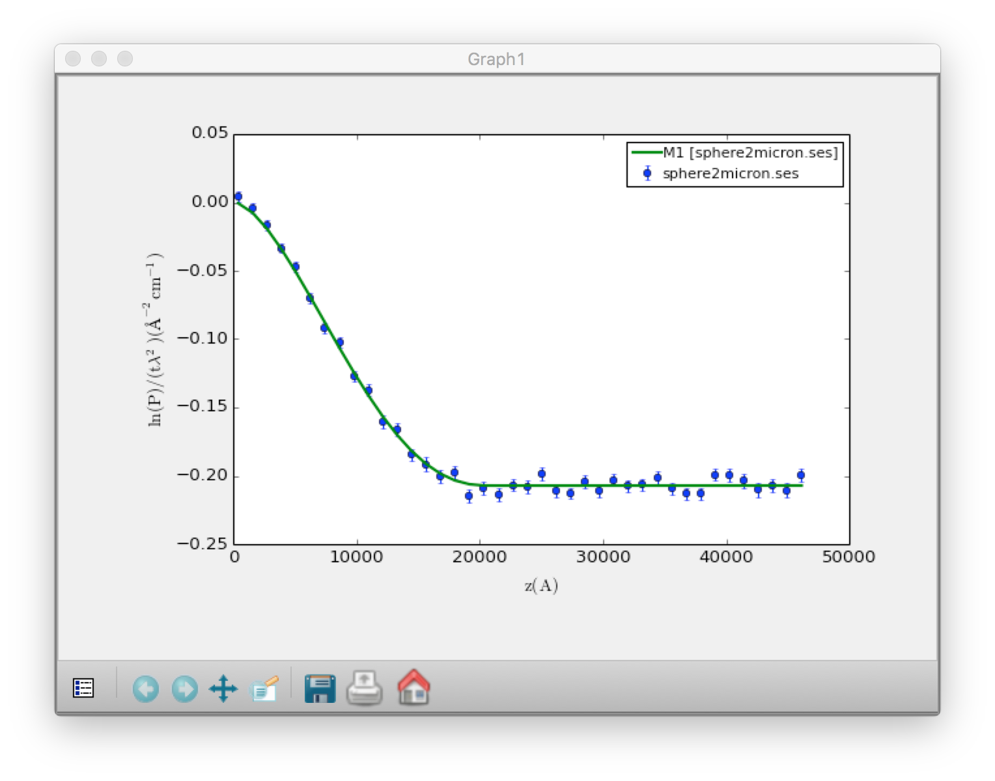
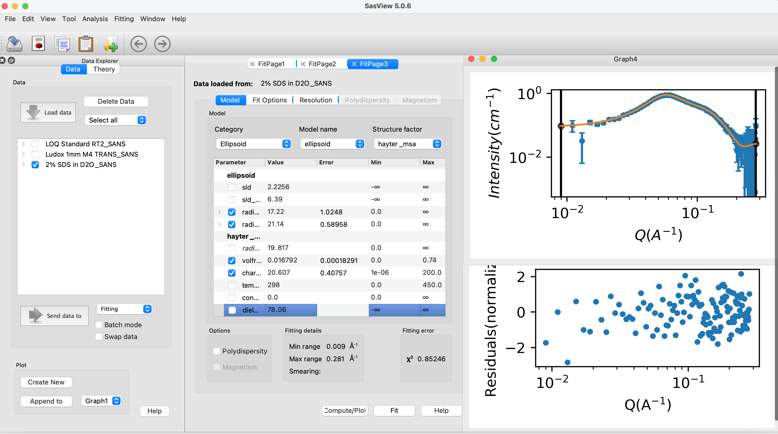
Fitting in SasView: 1D
Wide choice of built-in models (> 70)
P(Q), S(Q) & P(Q)*S(Q)
Single, batch and simultaneous 1D and 2D fitting
Also SESANS data
Data management
Common data formats supported, including NXCansas & cansas1D
Analysis Tool Choice
&
Plotting
Polydispersity (choice of distribution and distribution parameters)
Resolution smearing (pinhole and slit)
Automatically from data or provide parameters

Slide 19
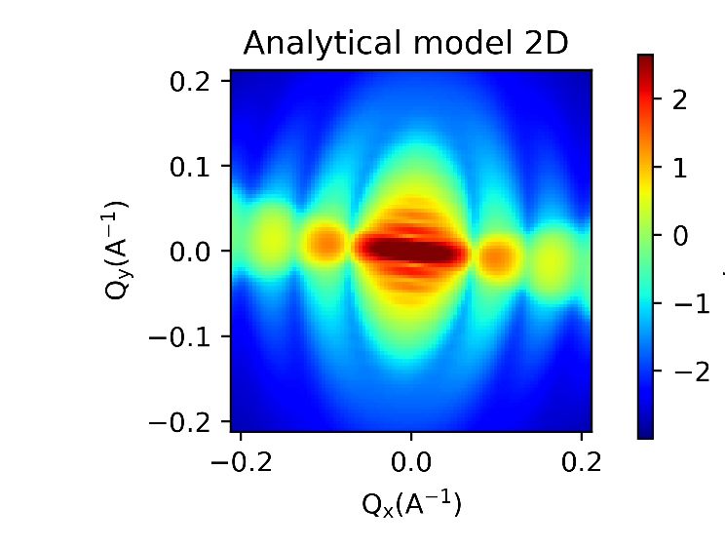
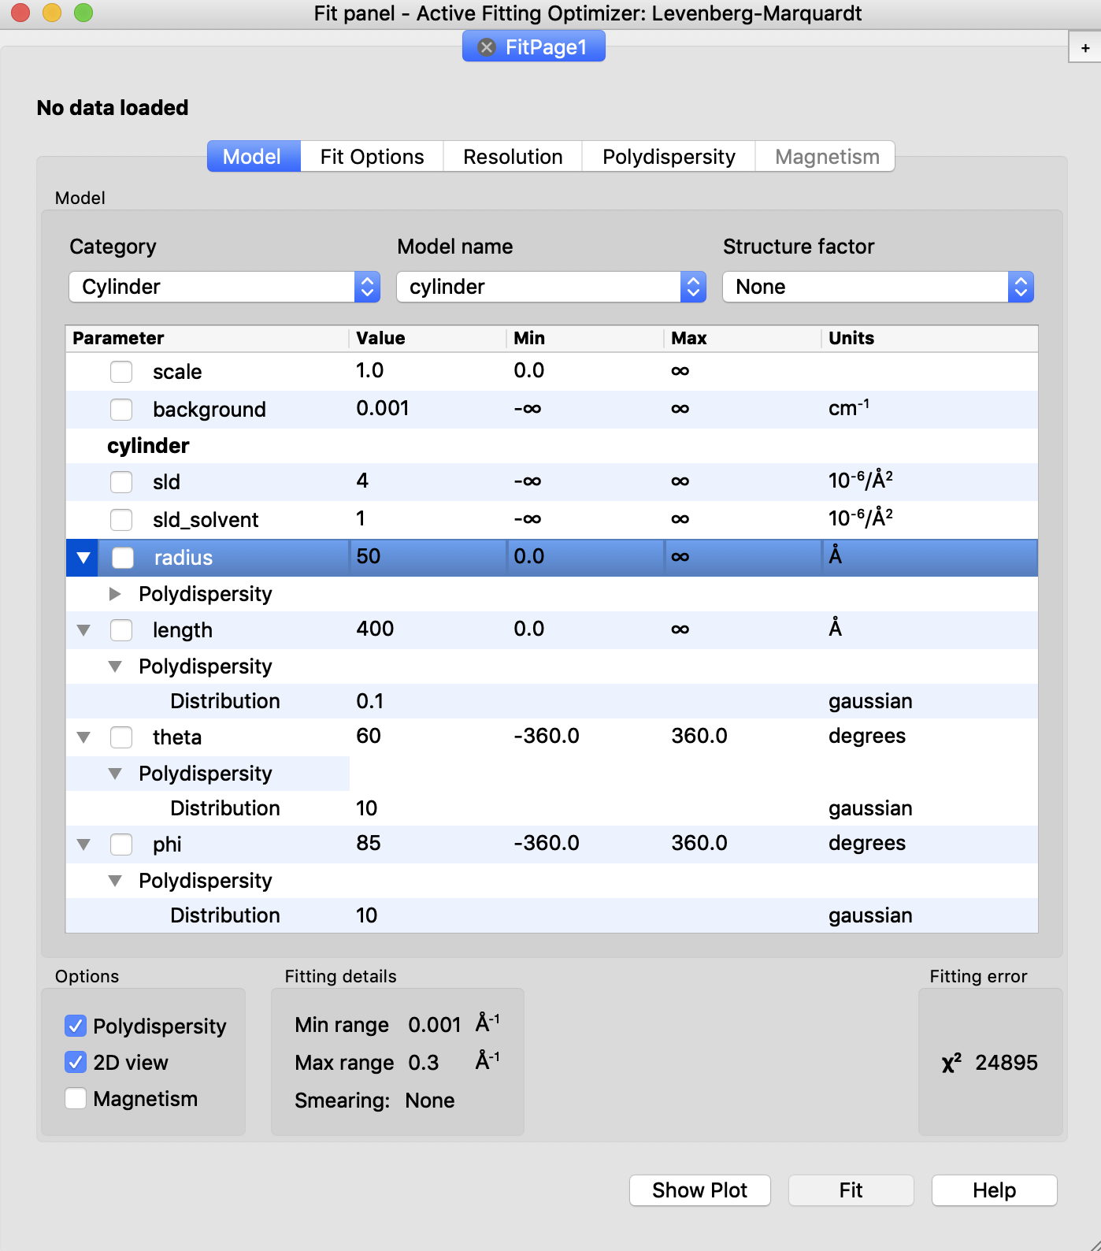
Fitting in SasView: 2D
Orientational polydispersity = “jitter”
Decouples the frame for the object’s orientation with respect to the beam and the “jitter” around the axis of the object.
Turning on GPU Option highly recommended for fitting

Slide 20
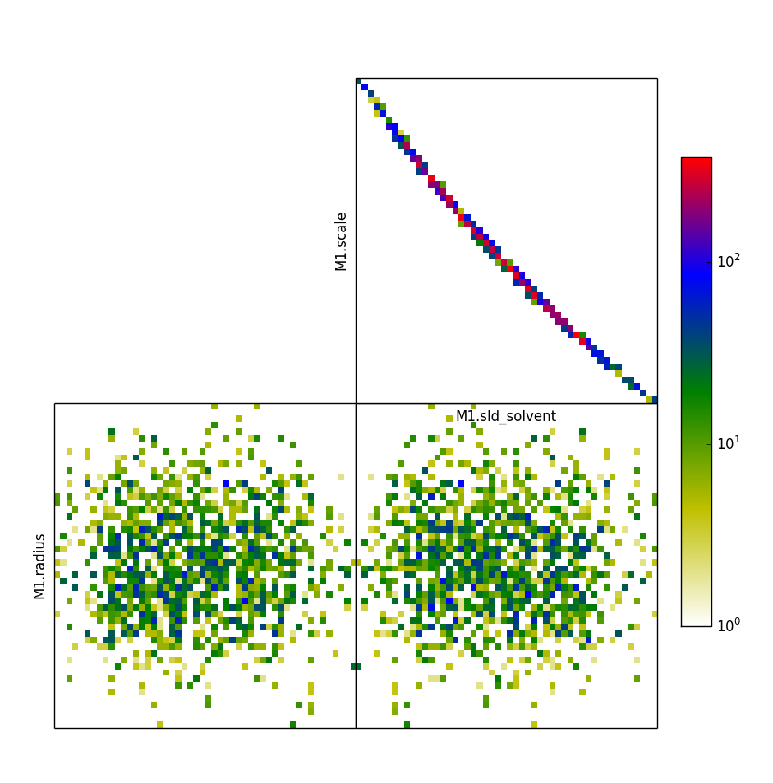
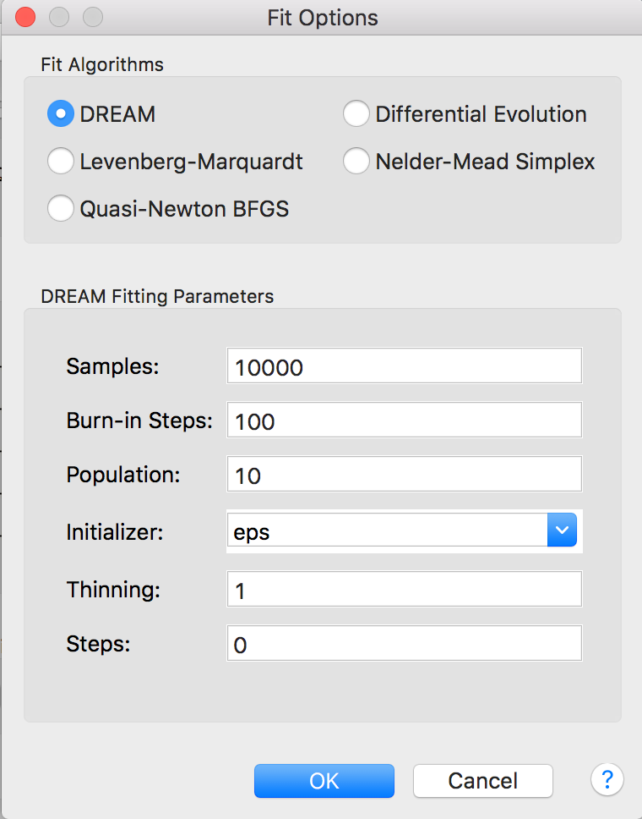
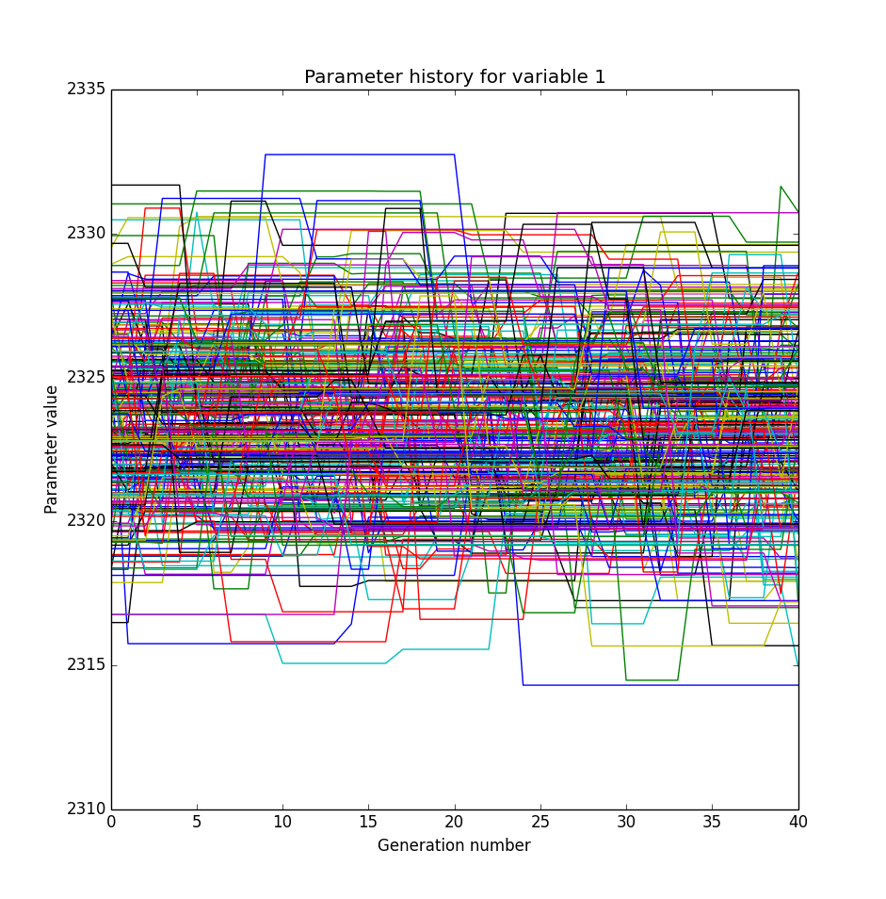
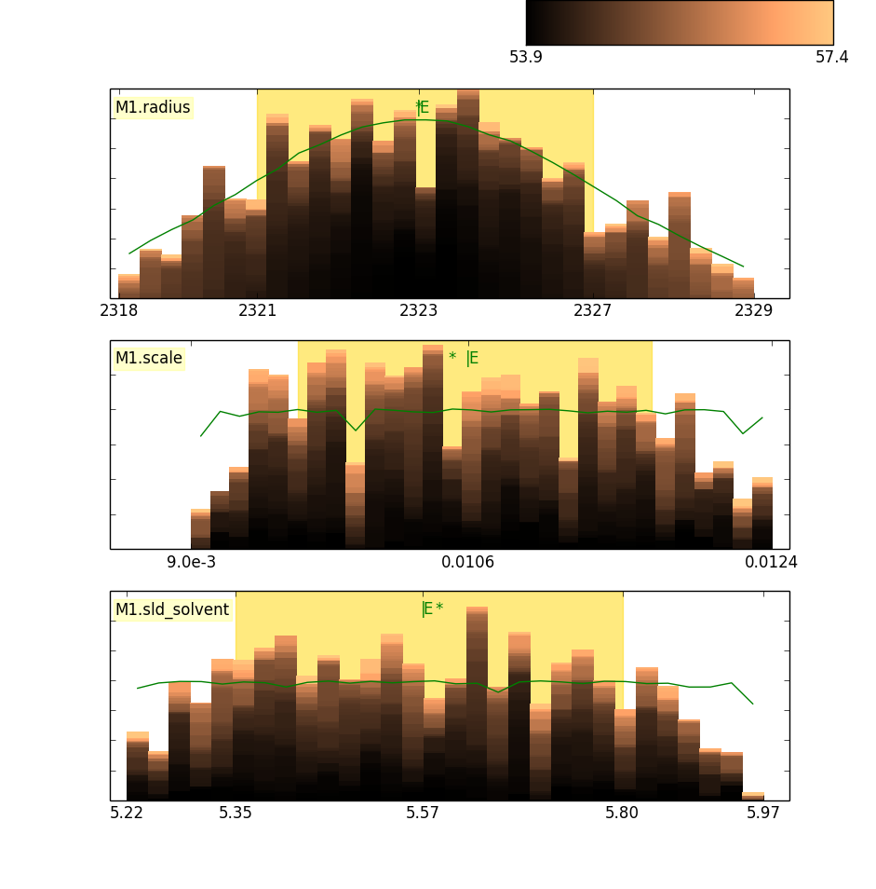
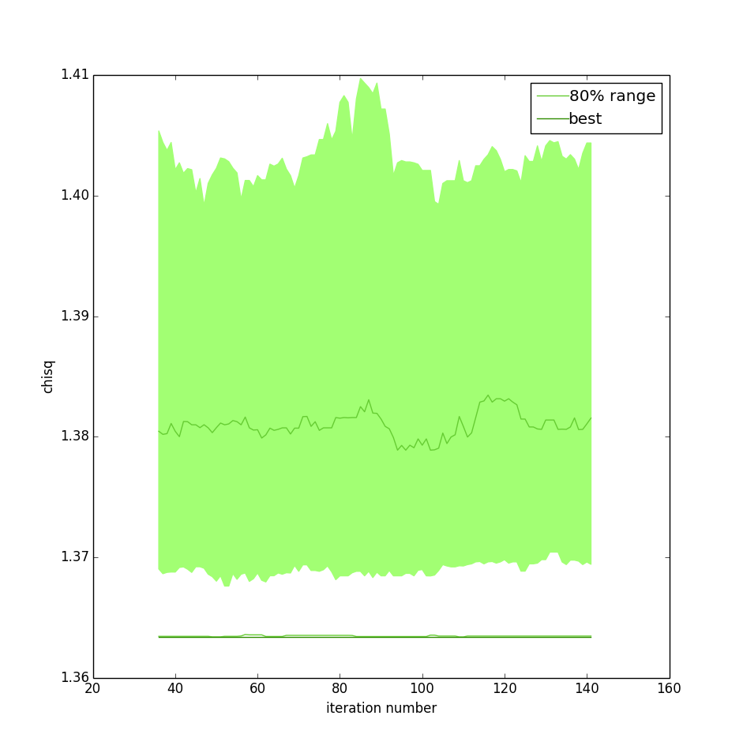
Choice of Fitting Algorithms
Uses bumps package from P. Kienzle
(also has DANSE origins)

Slide 21
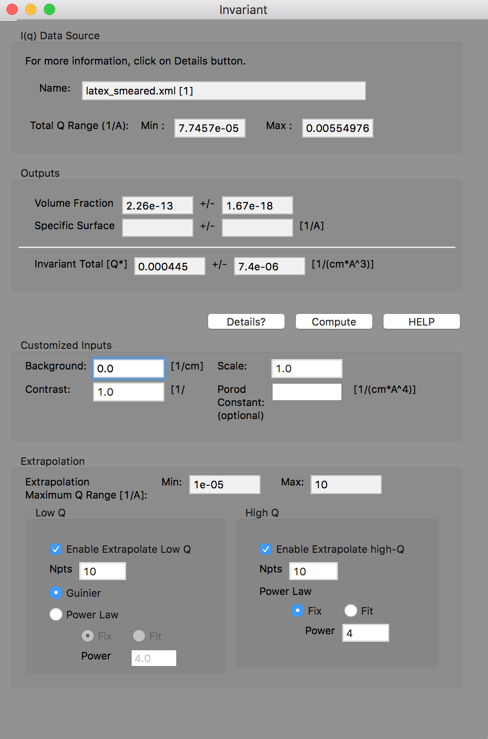
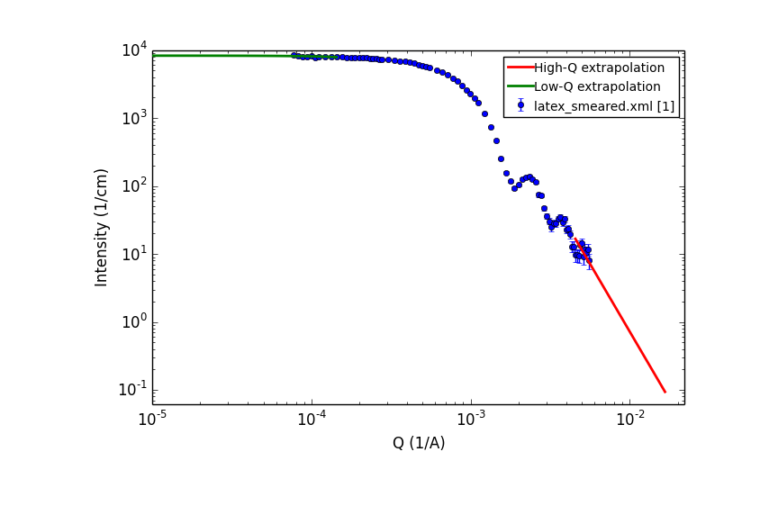
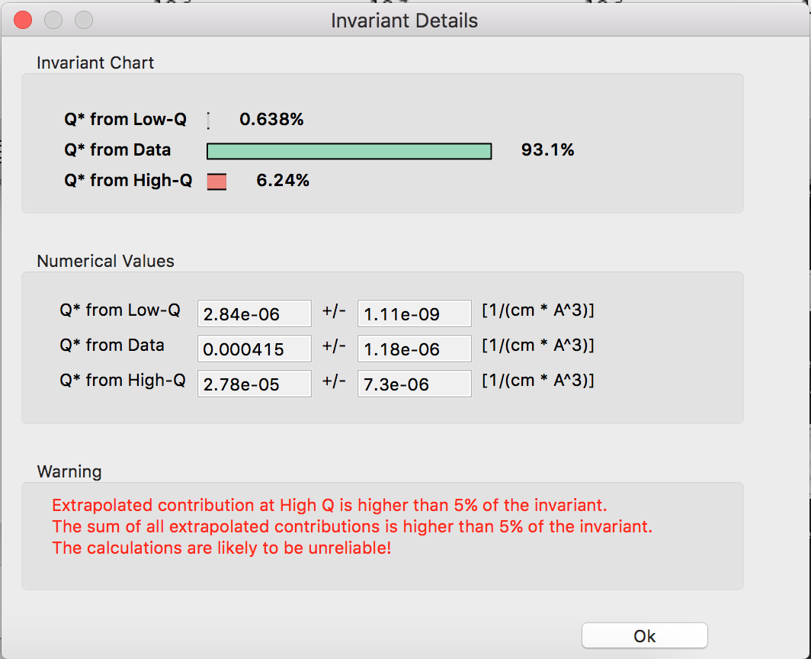
Invariant Analasis

Slide 22
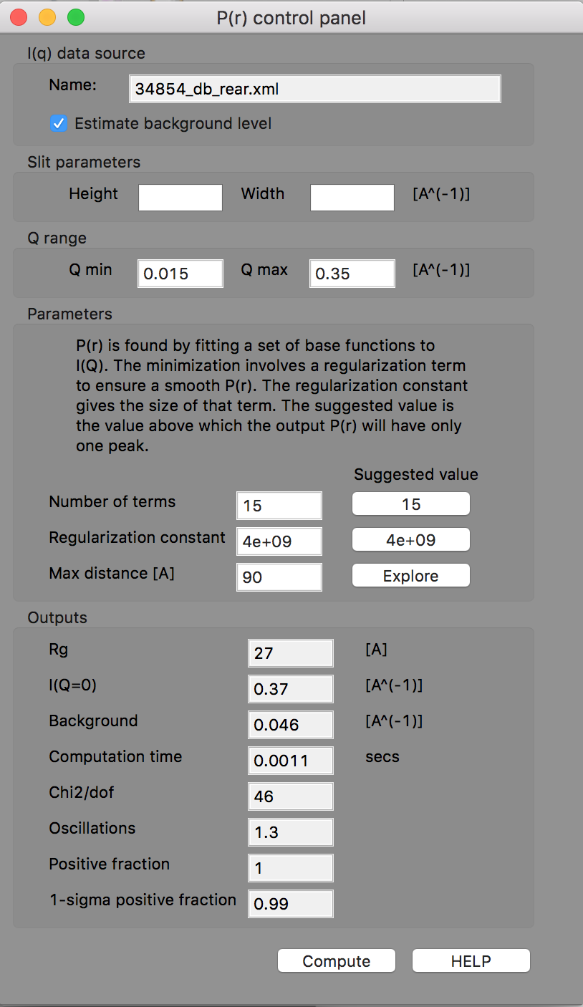
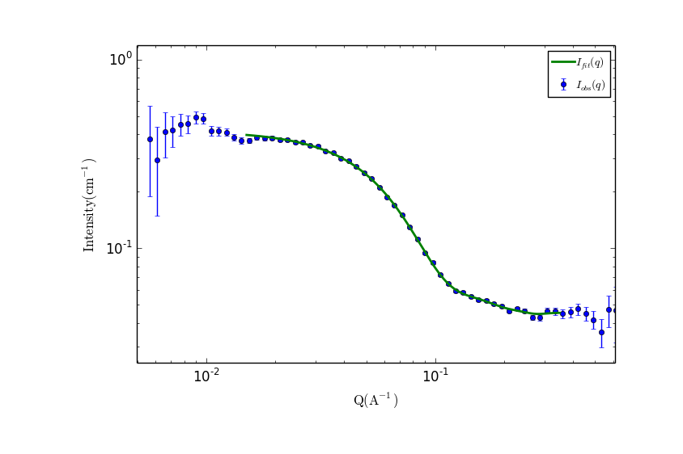
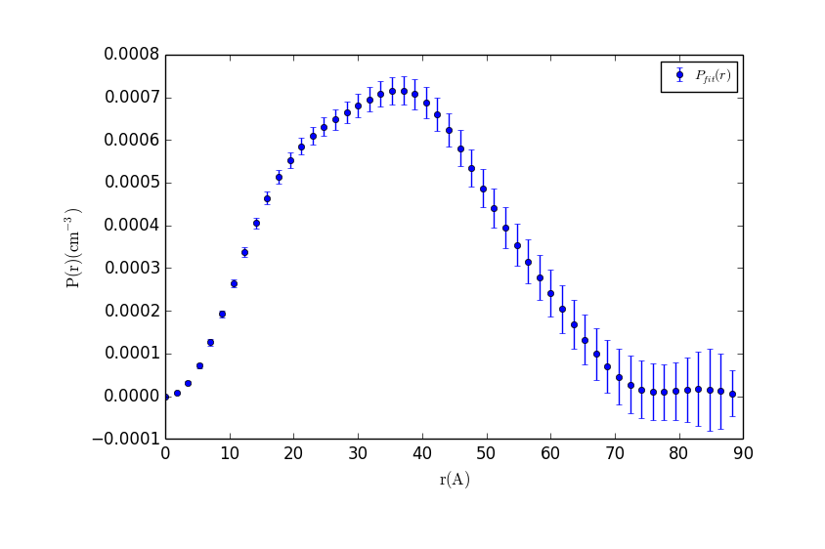
P(r) Inversion

Slide 23
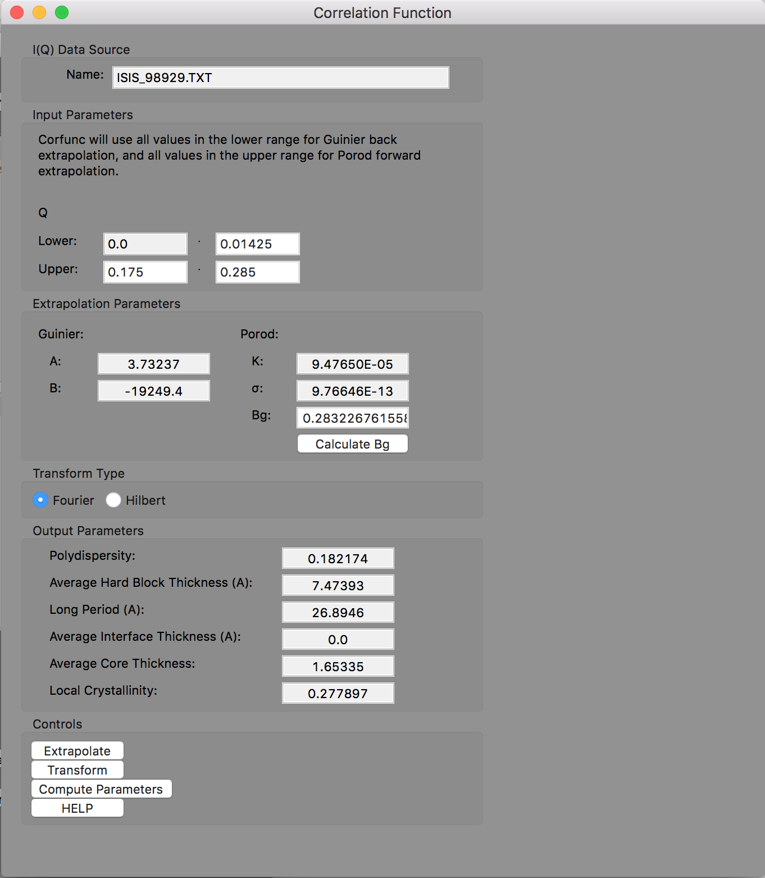
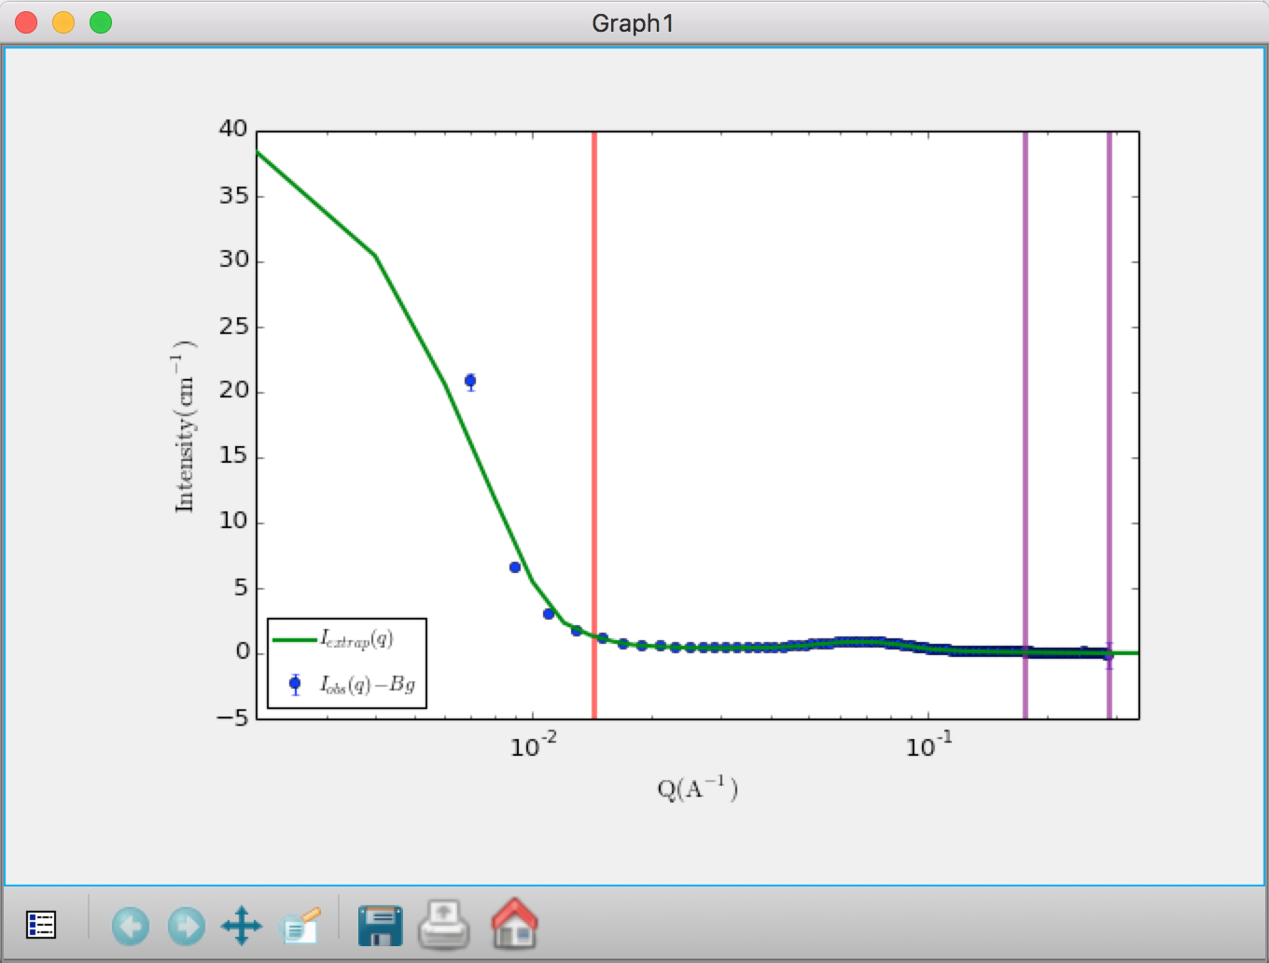
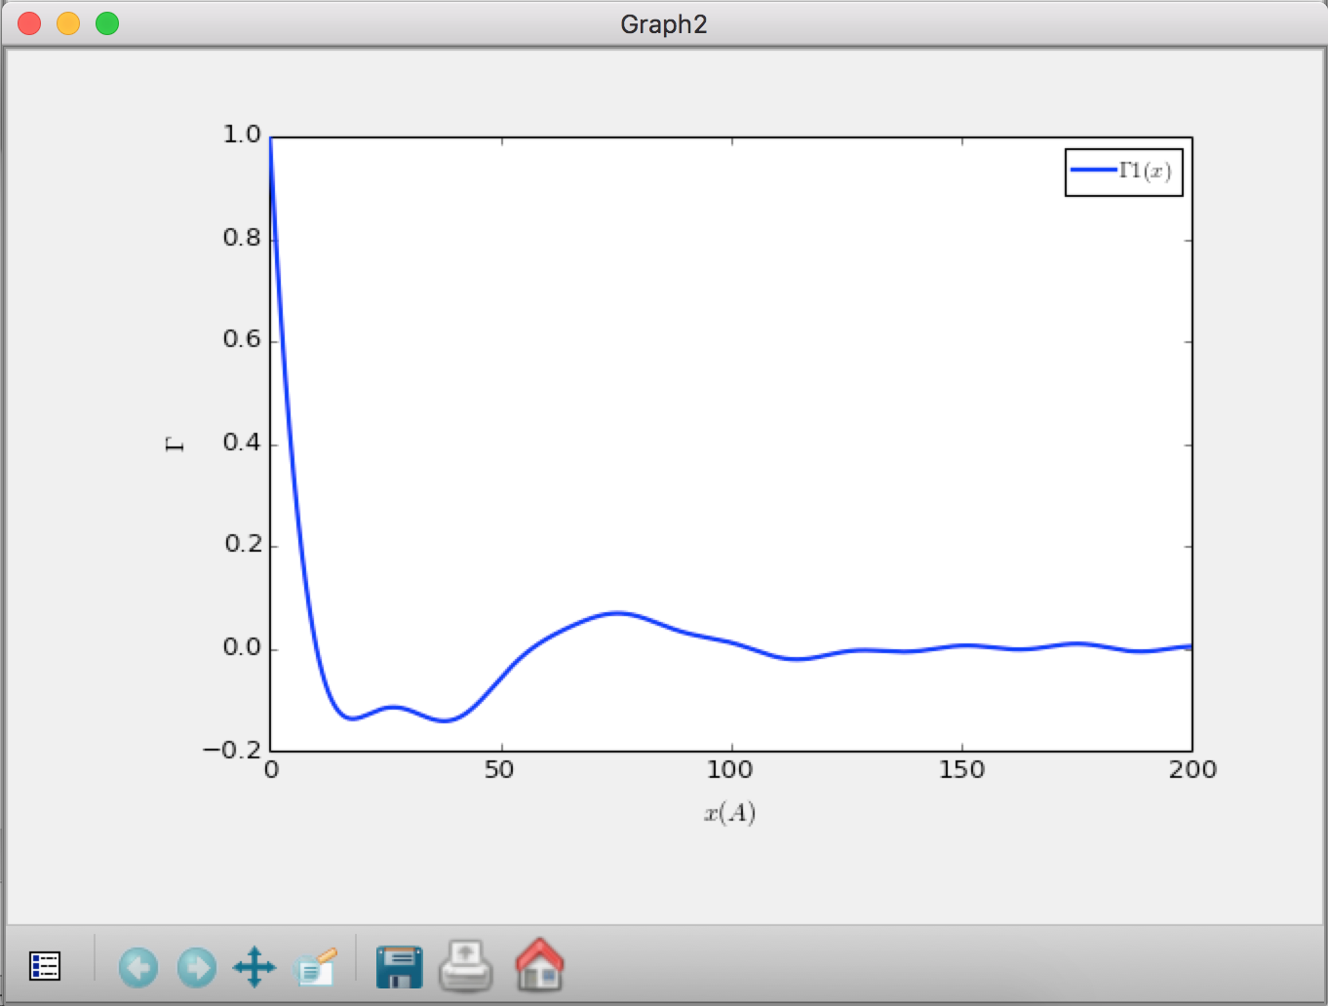
Correlation Function Analysis
Recently refactored
CCP13 (Fiber Diffraction) legacy code (Fortran)
(ISIS summer student)

Slide 24
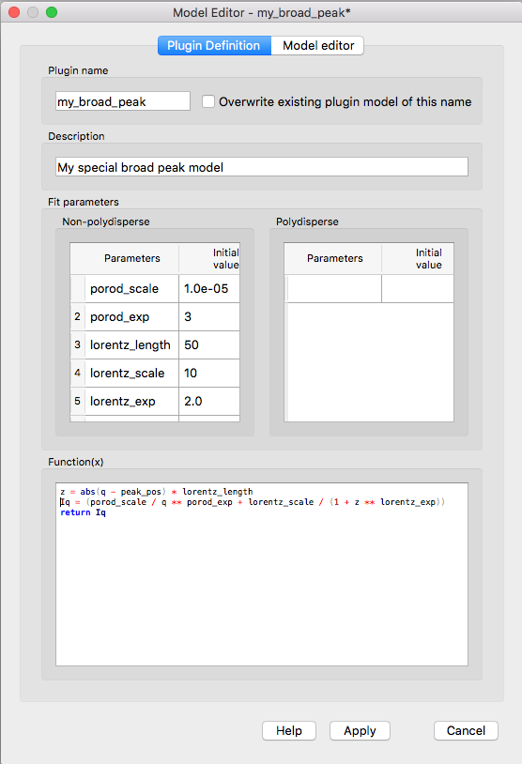
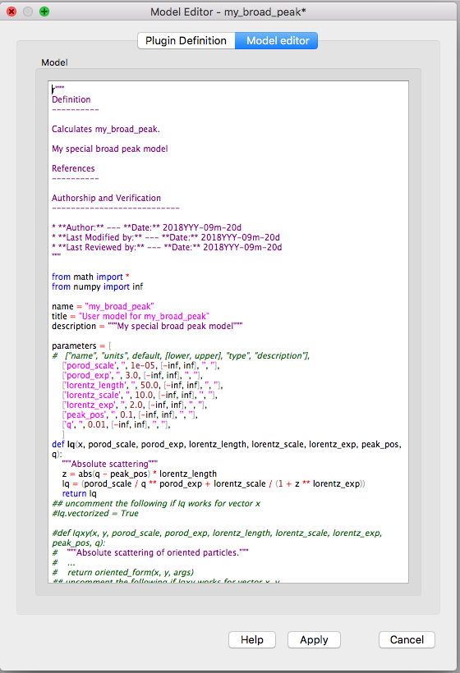
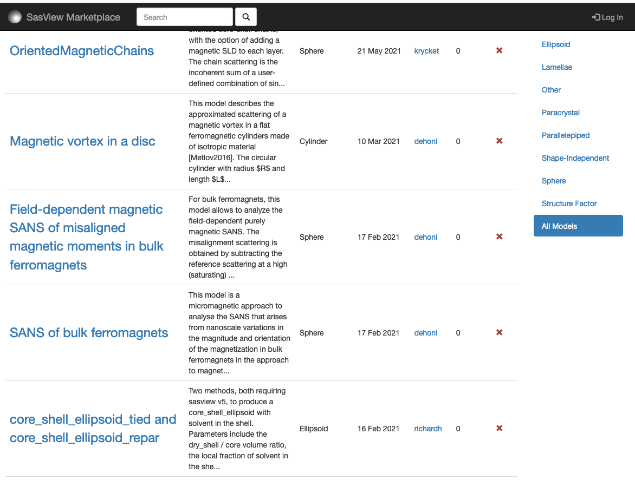
Pluging Models
SasView provides tools and infrastructure for custom/plugin models
Dedicated editor
Syntax and performance testing
Directly available in SasView ecosystem
Community developed models can be deposited to marketplace: https://marketplace.sasview.org/

Slide 25
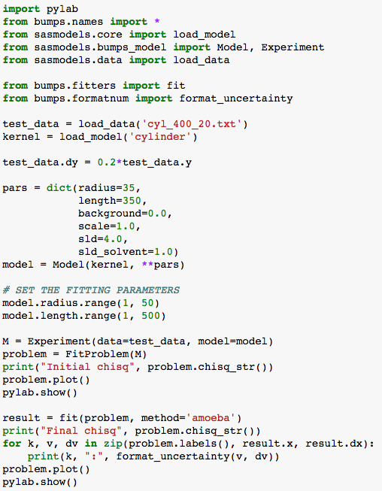
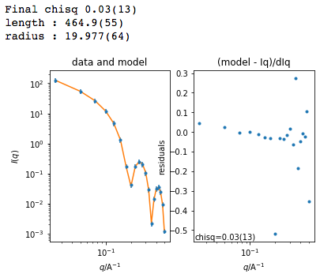
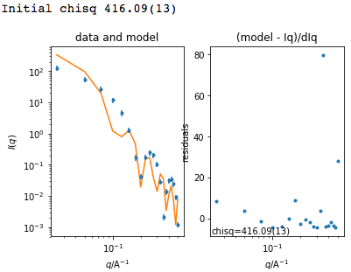
Beyond the GUI
Running SasView from scripts
Useful for batch jobs and reproducibility
Scripts can be run on computer cluster
Before fit
After fit

Slide 26
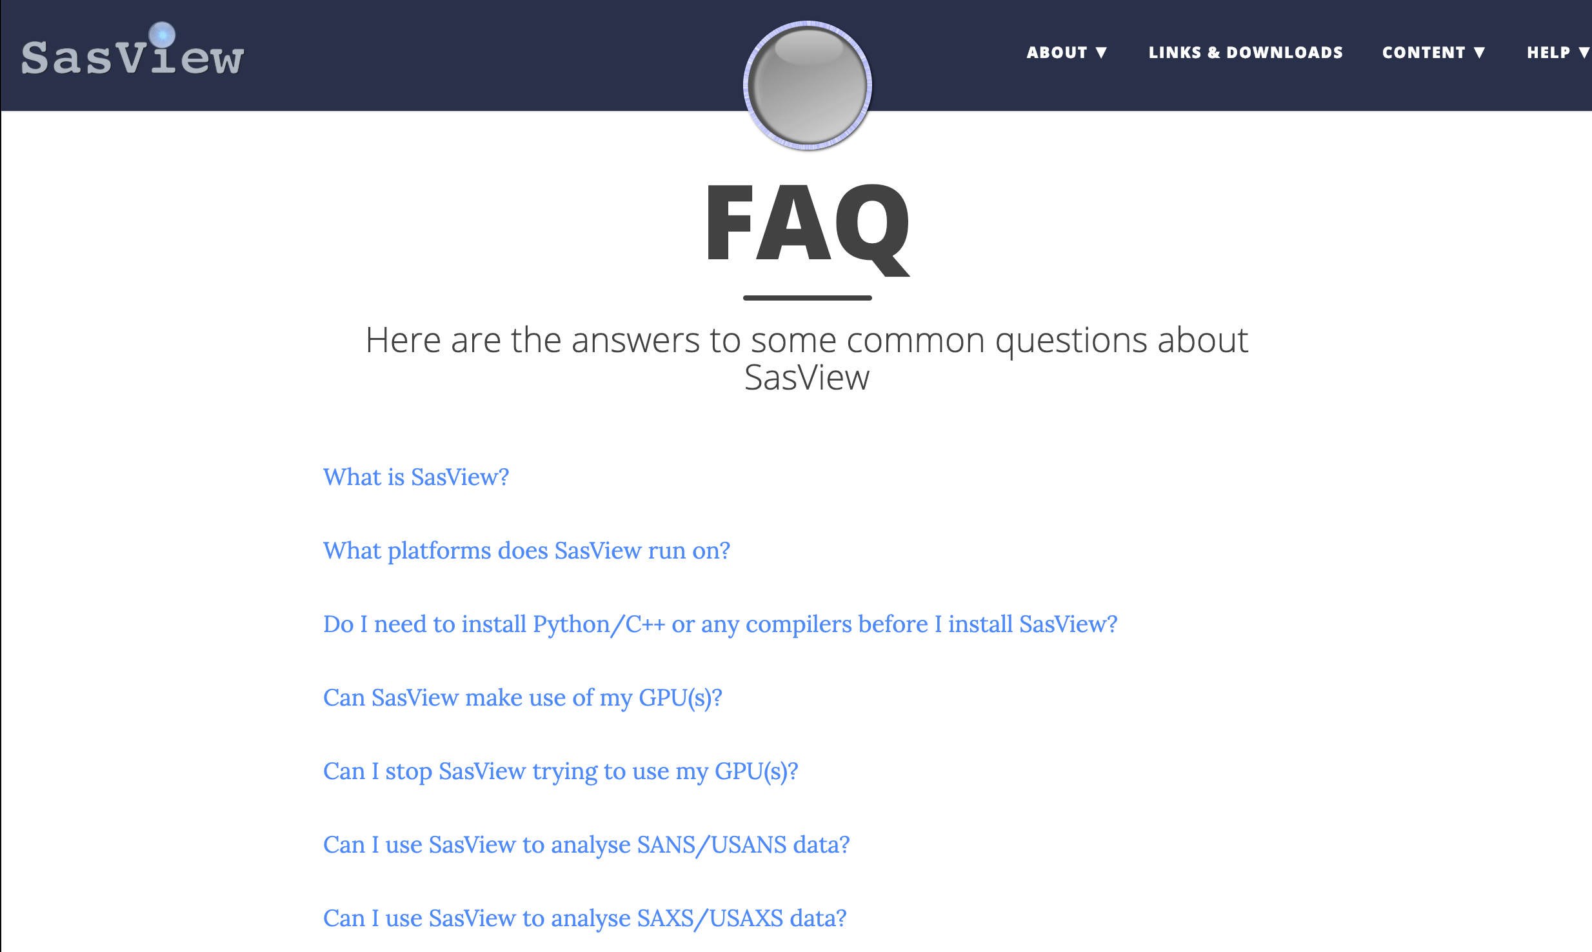
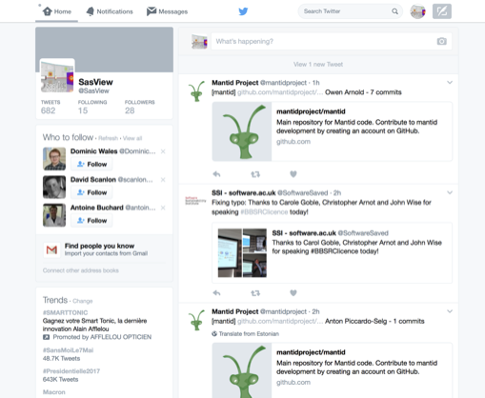
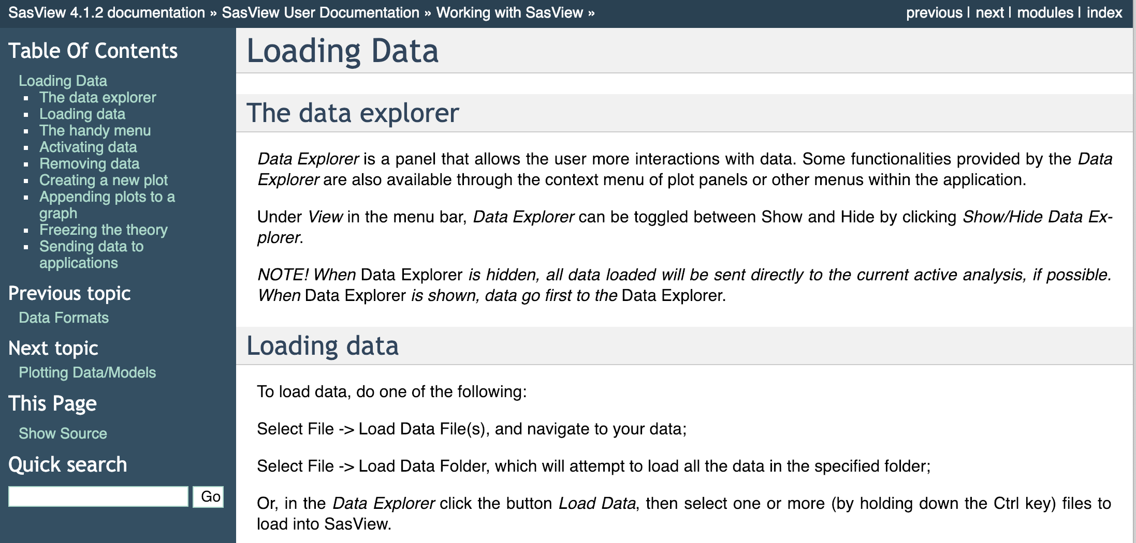
Resources, Education & Outreach
Website
Documentation
Written Tutorials
Video Tutorials (YouTube)
Taught courses
Scattering schools
University courses
E-learning
Twitter
Slack
Mailing Lists
Bootcamps & Regional Workshops
(Marketplace)

Slide 27
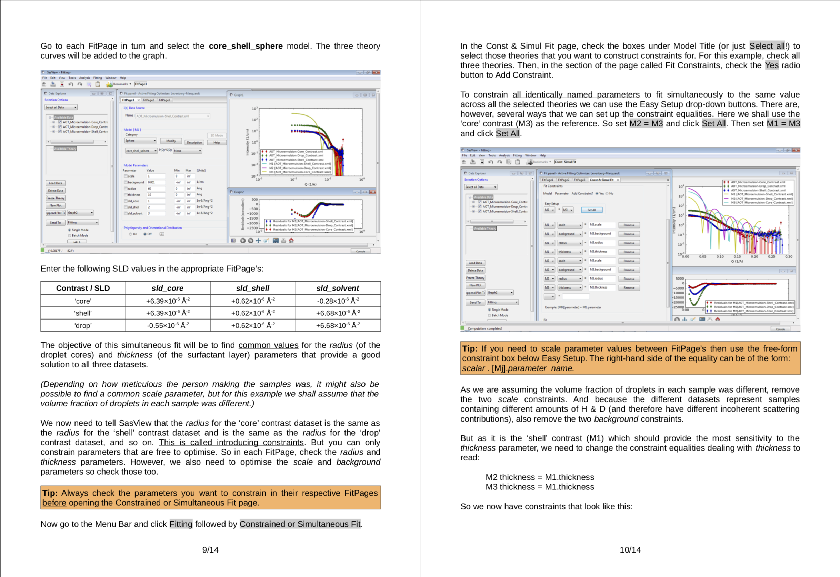
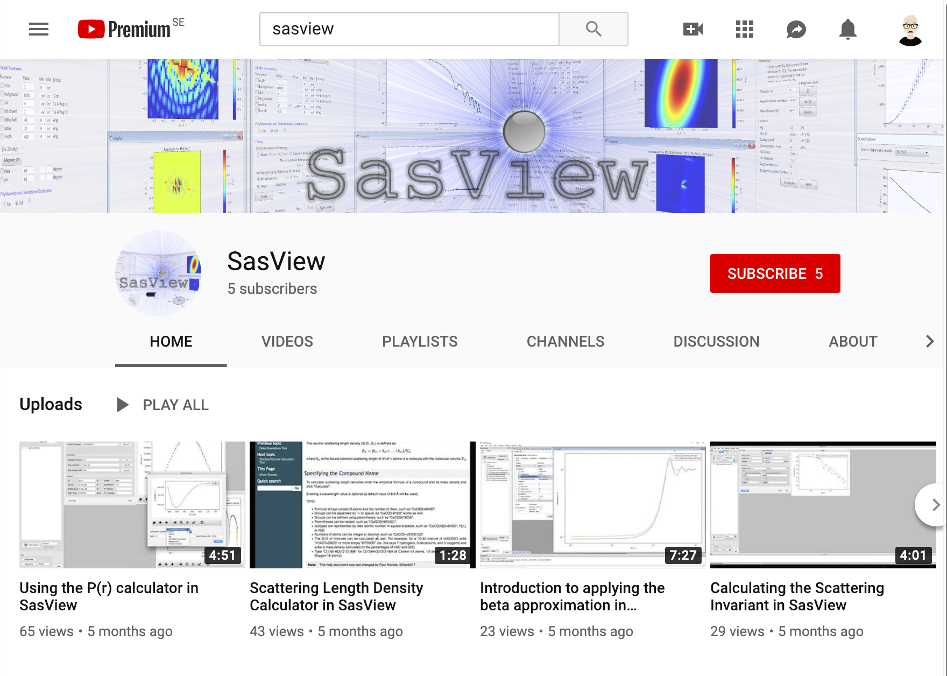
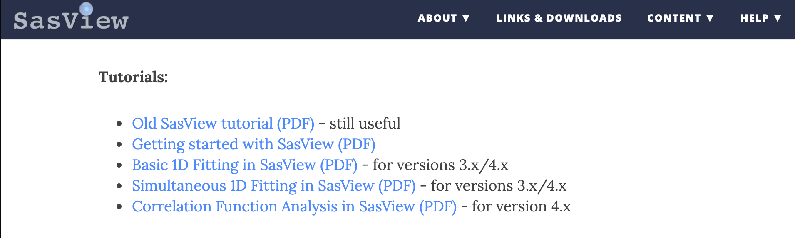
Resources, Education & Outreach
Website
Documentation
Written Tutorials
Video Tutorials (YouTube)
Taught courses
Scattering schools
University courses
E-learning
Twitter
Slack
Mailing Lists
Bootcamps & Regional Workshops
(Marketplace)

Slide 28
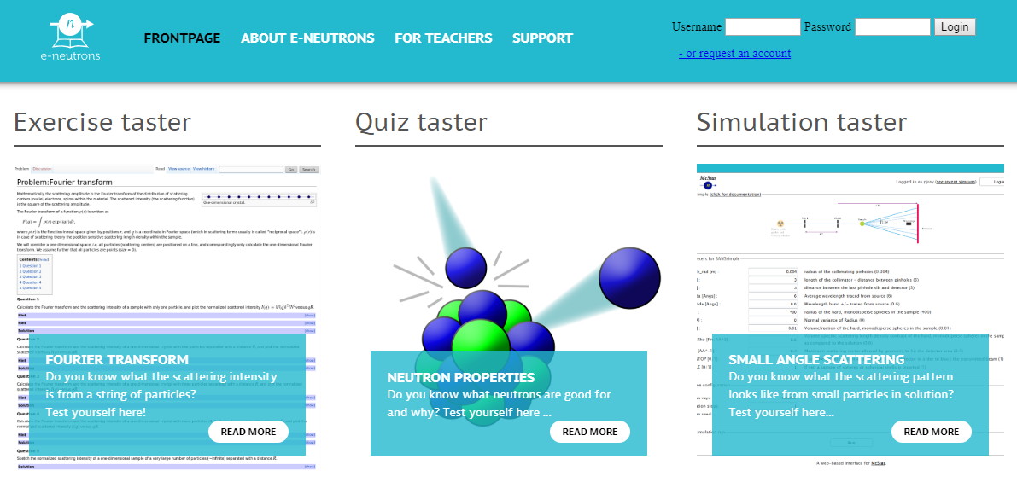

Resources, Education & Outreach
Website
Documentation
Written Tutorials
Video Tutorials (YouTube)
Taught courses
Scattering schools
University courses
E-learning
Twitter
Slack
Mailing Lists
Bootcamps & Regional Workshops
(Marketplace)
All the work of ISIS Sandwich Student Michael Oakley

Slide 29
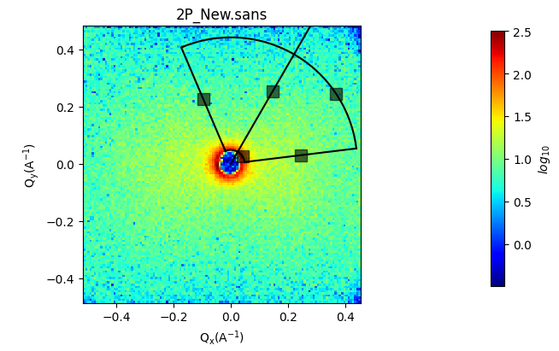
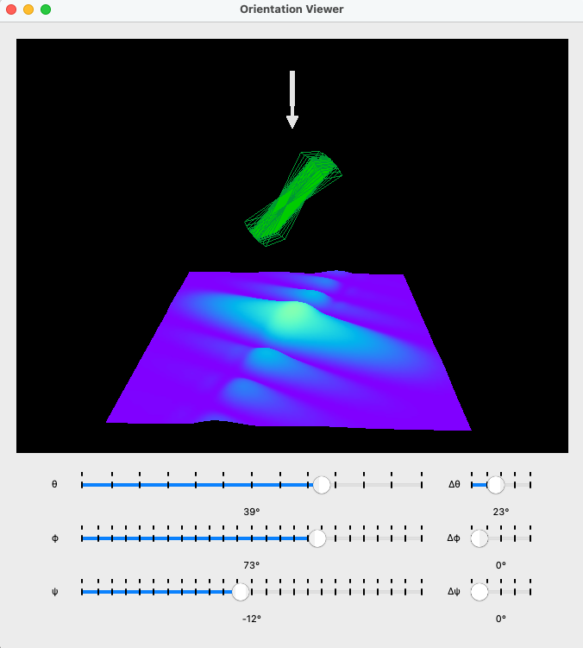
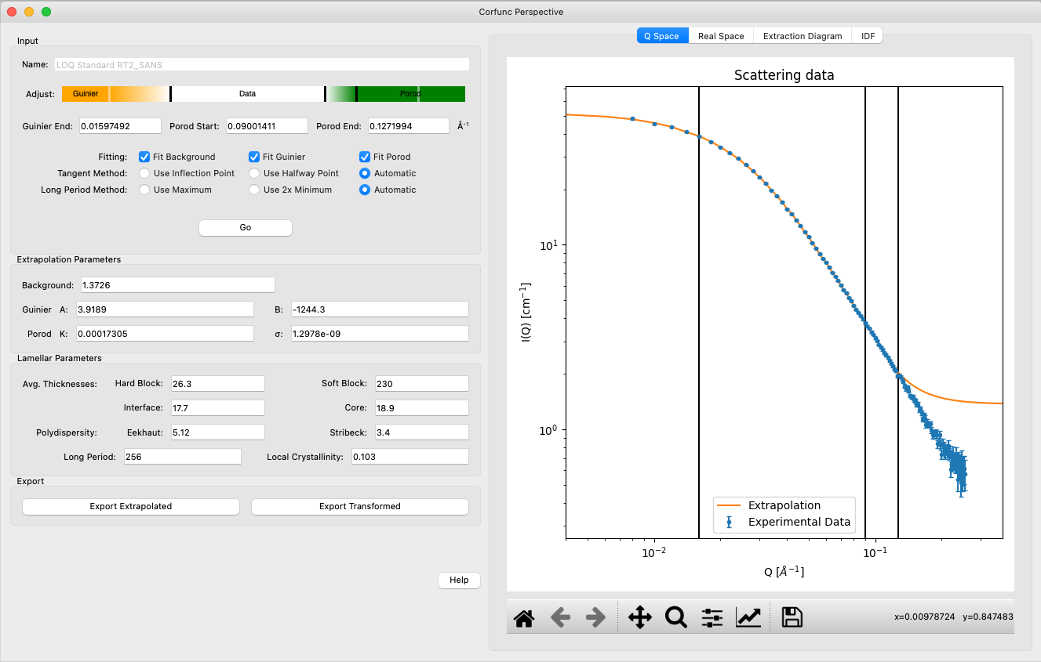
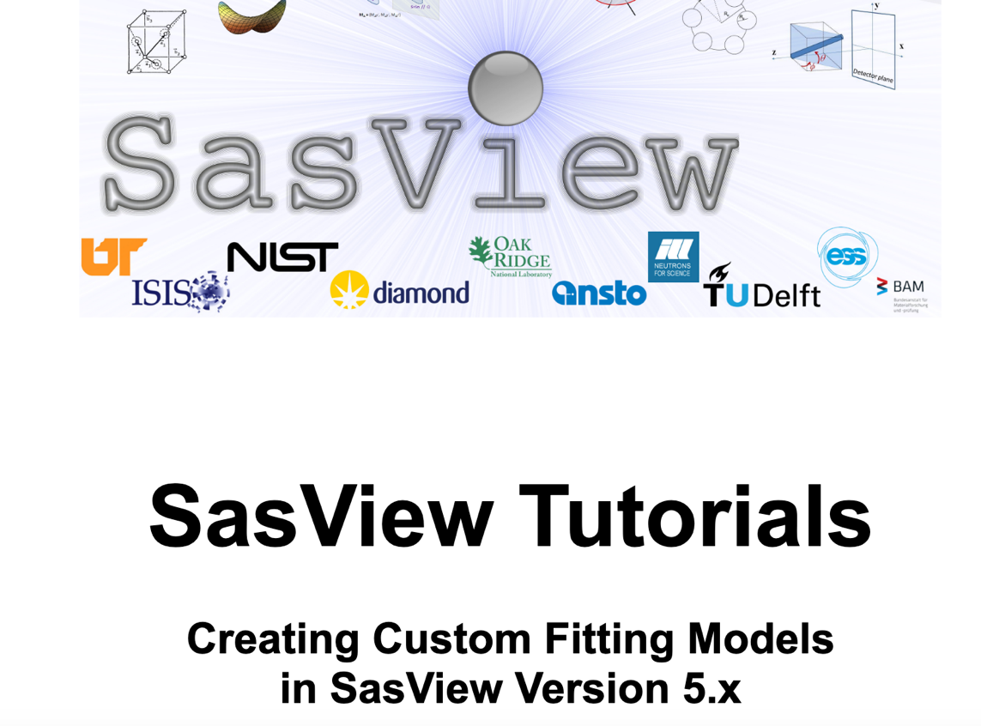
A taste of things to come – SasView 6.0.0-alpha
Use at your own risk...
Orientation viewer available
Corfunc perspective refactored
Simultaneous fitting allows for a weighting scheme
Preferences panel with display and plotting options
Improved label handling on plots
Residuals plots refactored
PDB reader refactored
Wedge slicer added
Sasdata package separated
Custom Model writing tutorial

Slide 30
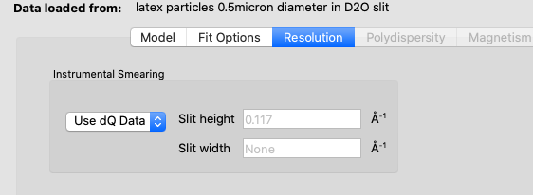
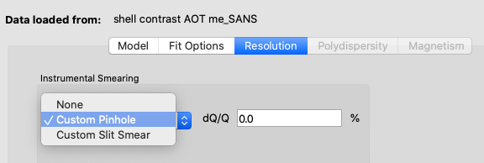
Towards Generic Resolution Functions
Data reduction (resolution values)
File with q, I(q), dI, dQ
Data Analysis (reads in dQ from file)
In SasView:
File with dQ
<Idata>
<Q unit="1/A">0.00714</Q>
<I unit="1/cm">226.539</I>
<Idev unit="1/cm">1.93973</Idev>
<Qdev unit="1/A">0.00144239</Qdev>
</Idata>
File without dQ

Slide 31
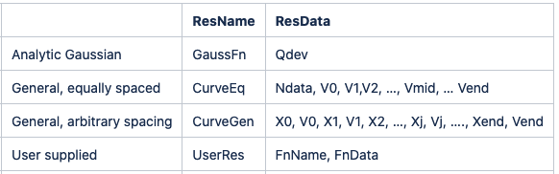
Towards Generic Resolution Functions
Working with canSAS to extend NXCanSAS format with defined labels
NXCanSAS placeholders:
/entry/data/q/resolutions
Dataset name corresponding to Q resolution data
/entry/data/q/resolutions_description
Can be a simple description (i.e. Gaussian) or metadata on Q resolution data
Notes:
We will presume that a CanSAS hdf format file is going to be used. The normal historic “Gaussian equivalent” standard deviation provided by an instrument Qdev(Q) should always be provided

Slide 32
SasView Model: Some Current Challenges
The tragedy of the commons: somebody else will take care of the problem – New features are more interesting than fixing fragility issues
Hard to get non-coders to believe they can contribute equally – it is unfortunately in the name “code camp” … words matter → "Contributor camp"
Building community, especially during a pandemic is HARD WORK
Lack of funds for small things … but beware too much money?
Cost of writing sustainable/maintainable code is surprisingly high and can be a deterrent to new contributors
Hard to keep up with increasing security issues with the resources so far.
Heavily geared towards colloid science​
NEW: Magnetic SANS effort
The price of success:
Many people view the project as a well-funded group of professionals → barrier to contribution
Large project with many moving pieces is a barrier to new volunteer coders

Slide 33
Contributing to SasView
You don’t have to be coding ninja to help out!
Respond to queries posted to help@sasview.org or github
Teach others how to get the best from SasView
Write and improve documentation
Write and record tutorials
Test SasView (over and over!) and write bug reports
Provide new plugin models
Deploy and improve automated testing
Review the code contributions of others
Develop code in Python3/C and PySide2/Matplotlib
Server and Github admin task
Develop/improve databases (e.g. marketplace) etc.
www.sasview.org/contribute

Slide 34
Contributing Student Projects – Summer 2022 and 2023
Simultaneous SAXS and SANS fitting- Iestyn Cadwallader-Jones, supervisor: Miguel Gonzales (ILL)
Plotting improvements, benchmarking for hypergeometric functions- Nouhalia Agouzal and Dorian Lozano, supervisor: Miguel Gonzales (ILL)
Wedge slicer and improving slicer code - Ellis Hewis, supervisor Dirk Honecker (ISIS)
Extending scattering calculator for magnetic systems – Ruben Lopes, supervisor Dirk Honecker (ISIS)
Extending scattering calculator for Interacting bio-molecules – Alex Zheng, supervisor Yun Liu (NIST)
Local documentation generator and editor (plugin models) – Brayden Miller, supervisor Paul Butler (NIST)
Web-based API, Xael Shan, supervisor Jeff Kryzwon (NIST)

Slide 35
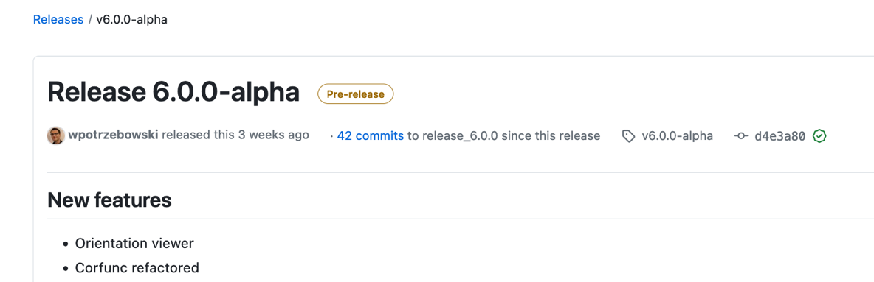


Resources for Contributors
Reducing entry barier and improving release cycles frequency
Faster release cycles
E-learning course
Contributor Camp
Save the date!
Jan 16th – 22nd 2024
University of Delaware, US
https://e-learning.pan-training.eu/course/view.php?id=52

Slide 36

What will SasView do in the future?
Whatever the community contributes.

Slide 37
The resource Problem – The SasView Solution
vertical and horizontal COLLABORATIONS
Facilities provide foundational support through participation of data and instrument scientists
Grants and other projects provide “bold new functionality”
Community, writ large, helps provide support and functionality
New ideas tested and developed as before by individuals or larger groups (the community)
Once validated and deemed ready for the larger community these groups provide resources (their labor) to integrate while active developer community helps with training on where things go and on parts of interest to them (collaborative)

Slide 38





Current Status of SasView
2006; originates in NSF DANSE project
2013; transitions into a community project
2016; Sine2020 project funded
2023; Essentially a “volunteer army”
--------------------
~40 contributors from 9 organizations so far (~10-15 active at any one time)
1 to 2 releases/year (5.0.5 JUST RELEASED)
Documentation/tutorial projects ongoing
Usage? Seems to be "everywhere?"
Lots of "complements" (a bit scary)
Publications? > 100/year

Slide 39


Come and Join the Fun! Contributor Camp XII Jan 16-22 University of Delaware
Things people are saying about SansView/SasView
‘SansView is a very helpful tool, very complete and easy to use’ - Niki
‘I want to thank you for this amazing software. It’s UI and options make the interpretation of spectra easier and faster’ - Philippe
‘I really like the SasView software’ - Martin
‘I have been using SasView as my software of choice for fitting SANS data, and I have been very happy with the software’ - Greg
‘I have found SasView very easy to use and the batch fit function is a wonderful time saving tool. I can finally stop making painful excel macros!’ - Andrew
‘I am a new user of SasView and I think it is a very useful and practical tool’ - Arnaud
‘Within 30 seconds…I am completely converted to SasView!’ - Mike
‘Thank you for creating and maintaining SasView. It is an incredibly helpful tool, and I use it regularly’ - Pasha
‘All the best and thank you again to carry on such a good job on SasView’ - Niki
‘Ooooh NICE PROGRAMME!! Hours of fun!’ - Stuart
‘I love such amazing software so much. It help our researches a lot.’ - Po-Wei

